Slide 1

respectme, Scotland’s Anti-Bullying Service
Online Safety Training
Lisa Armstrong

Slide 2
Training Aims
Consider what we mean by bullying, including on–line bullying
How young people use technology-the risks & challenges
To think about our role in keeping our children safe online
Practical skills to ensure safe, secure settings
Learn from each other !!!!

Slide 3
What Do We Mean By Bullying?
Bullying is behaviour that has an impact on a person
Bullying can make people feel hurt, frightened and left out
Even if the behaviour stops, the impact can last a long time
Notes:
This is not an exhaustive list. It is important to take into account impact when defining bullying behaviour. It is behaviour which leaves people feeling helpless, frightened, anxious, depressed, demeaned. Actions can affect people in different ways and this should be taken into consideration.
We use this simplified version for a lot of the work we do
How would you sum up the root causes of bullying?
Bullying is about relationships - when they aren't working, or they're not built on respect, bullying flourishes

Slide 4
Bullying Behaviour Can Include:
Being called names, teased, put down or threatened
Physical confrontations-hitting, kicking
Having belongings taken or damaged
Being ignored, left out or having rumours spread about you
Receiving abusive messages or posts
Being targeted because of who people think you are
Notes:
This includes behaviour online – cyberbullying or online bullying is not a completely separate phenomenon
It s another place bullying happens and frequently happens face to face, behind your back and online

Slide 5
What is Online bullying?
The same type of behaviour but it takes place online:- On social media, online gaming, texts, instant messaging
Online bullying, like all bullying behaviour is never acceptable. It is not a normal part of growing up.
Switching off the internet is not the answer
Notes:
Online bullying is the same behaviour done by the same people. It’s still largely done by people who know each other. 92% of children in our survey said that they knew the person. Relationships and connections play out online and face to face.
Face to face bullying however despite what the media may lead you to believe is more prevalent. Cyberbullying is more visible but not more prevalent.

Slide 6
Communication…It’s good to talk!
Discuss the methods of communication you used in your:
Teens
Twenties
Now
How did your communication methods change through time and why?
Do you feel these changes were positive or negative?
Notes:
In groups discuss how carers and parents communicated with friends/family/peers etc around them in their teens/their twenties and 30+. Getting them to highlight the technologies they used (if any) and how these have changed with time, and if they feel the changes have been positive or negative and why they think this.
Key Points:
In most, advances in technology have made our lives easier in some way or another e.g a text if your going to be late, a FB or skype message to telling someone your thinking of them from far away or being able to check your emails whilst out and about.
Gone are the days of having to arrange a date a week in advance with a place and time with no contact in between! Or going to the phone box in the pouring rain to speak to a friend, running out of change and getting cut off half way through a conversation!
Having to hold more meetings as we did not have email, telephone or video conferencing.
By and large technology has made our lives and the way we communicate a lot easier so how is it technology gets such bad press?… I’ve never heard of a computer bullying anyone…have you? Ask participants to hold that thought and move onto Agree, Disagree, Unsure? activity.
The real focus has to be on how we work alongside children and young people in educating them how to use technology safely and sensibly.

Slide 7
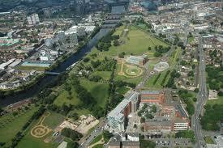
The Internet is a Place, Not a Thing
Notes:
Core message in all training
Social space
In/out of school it’s a place where things happen to people and they carry the impact with them
Okay to check messages from time to time – especially in the beginning
Pass codes etc
We would’nt share our bank / credit card passcodes – surely our children’s safety is more important ….it’s about encouraging trusting relationships.

Slide 8
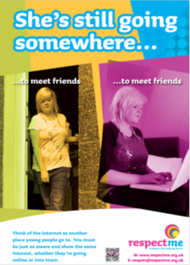
Still Going Somewhere
Notes:
So what is the message about the online world?
Not about being nosey or intrusive – about ensuring we develop trusting relationships with our children ….and doing our best to keep them safe.
It’s all about parenting.

Slide 9
What Risks Face Our Children and Young People?
Bullying
Exploitation – predatory behaviour
Violence
Abuse
Blackmailed/coerced
Left out
Scammed – ripped off
Gossip or lies
Do these take place on–line, or face to face?
Notes:
These behaviours take place face to face and on line – not mutually exclusive.
This tells us where they are going
Those are the places parents and professional need to focus on
Real risk in addressing cyberbullying in isolation
There are risks in addressing any on-line behaviour in isolation
The new skills are in understanding what they are doing on line and where they are going
Its still people being nasty to other people – it will most likely have spilled over

Slide 10
How Do We Support Our Children To Be Safe Online?
How to eat at the table
Learning to swim
Riding a bike
Crossing the road
Playing games
Stranger Danger
……..and learning to be safe online?

Slide 11
What Parents/Carers Need To Do
Communicate/build a trusting relationship
Let them know you are there to help if something upsetting happens online
Have an agreement about what’s allowed on the internet- Be a good role model!
Take time to teach & discuss about keeping safe online e.g. passcodes, location settings, blocking & reporting, their online behaviour, being share aware
Check/set privacy settings & parental controls
Be aware of age restrictions for sites, apps, games

Slide 12
And finally…
Keep the discussion about internet safety open and on-going
Remember settings are public by default and need to be changed
Only then can you control who is able to see pictures and posts. If I can see it I can copy it!

Slide 13
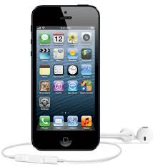
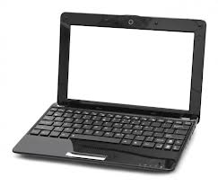


Practical Session
Notes:
Messages for our young people
Relationships play out online and offline at the same time for many young people
Be respectful of other people’s privacy
Protect your personal information
If you wouldn’t say it - don’t send it!
Everything you send can be traced
Be respectful in everything you do

Slide 14





Where Are They Going?
Always changing

Slide 15
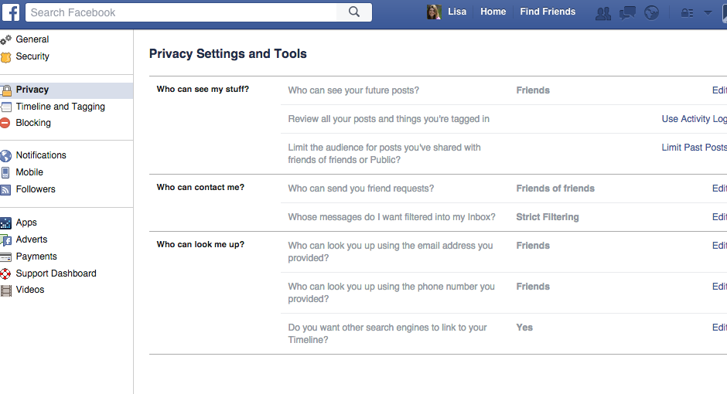

Facebook
Click here to open drop down menu
Click on Privacy button

Slide 16
Friends is safest setting

Slide 17
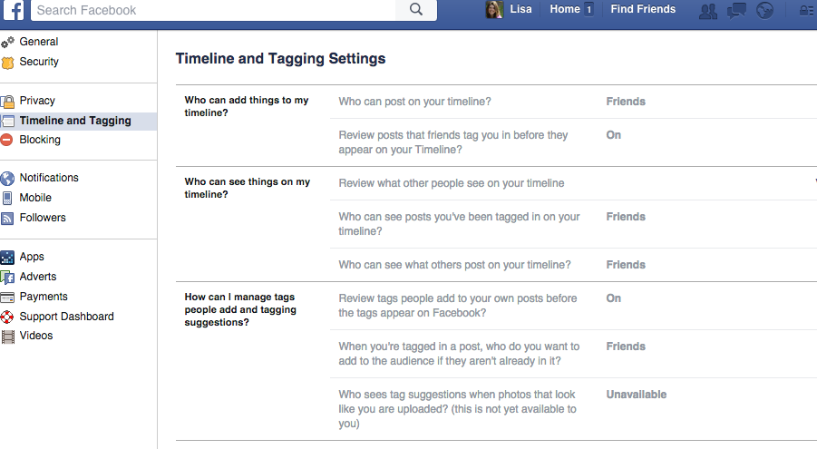
Friends is safest

Slide 18
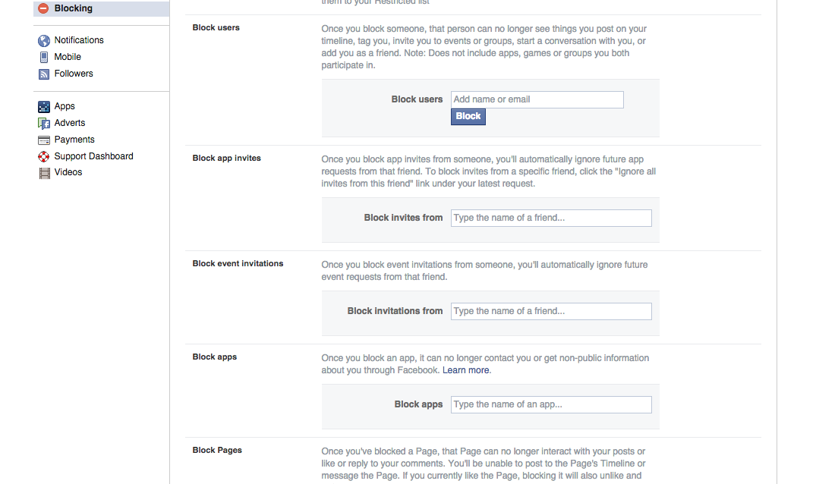
Type name of contact you would like to block here

Slide 19

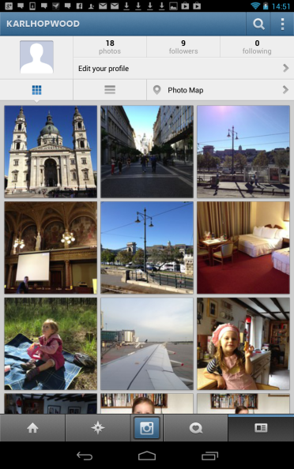
Instagram
2. Click on the settings icon
1. Click on the address card icon to open your profile

Slide 20
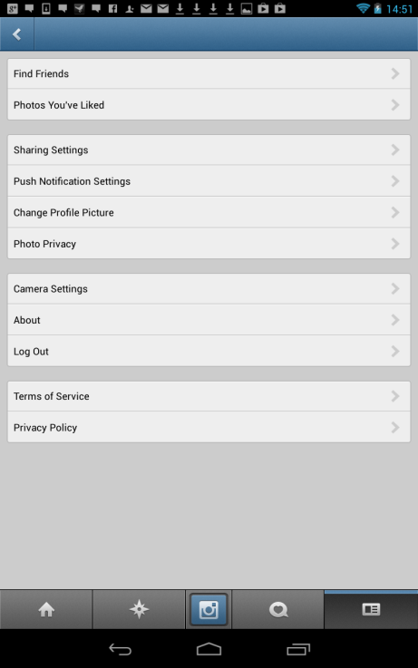
Instagram
Scroll to “
photo privacy” option and click on it

Slide 21
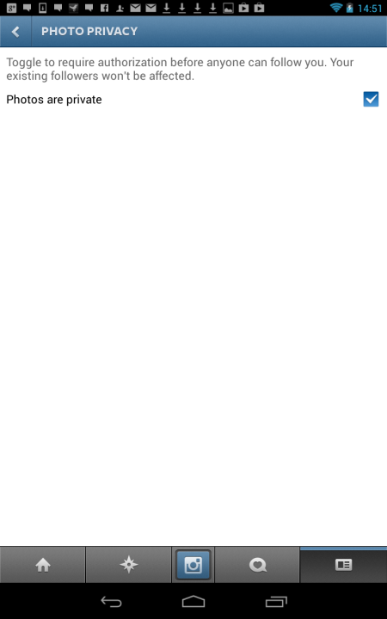
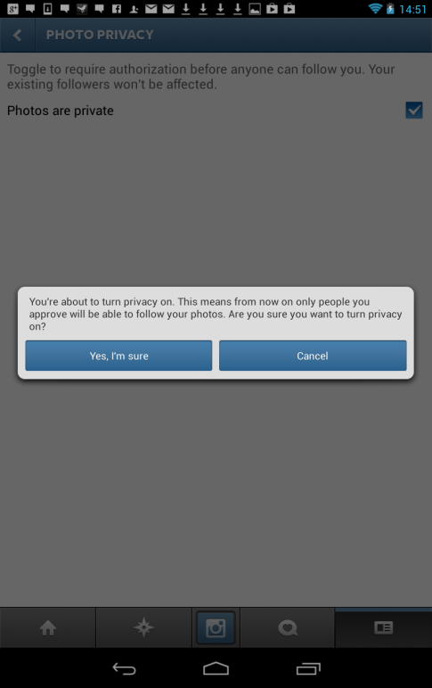
3. Make sure that the “photos are private” box is ticked
4. Click
“Yes I’m sure”
1. Click on the address card icon to open your profile

Slide 22
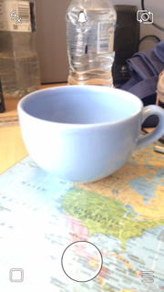
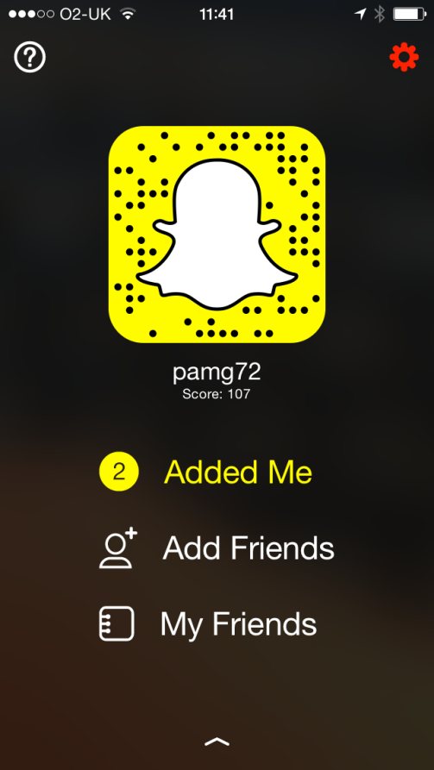
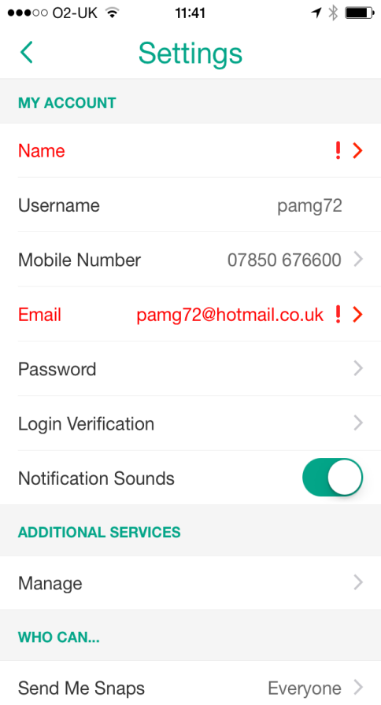
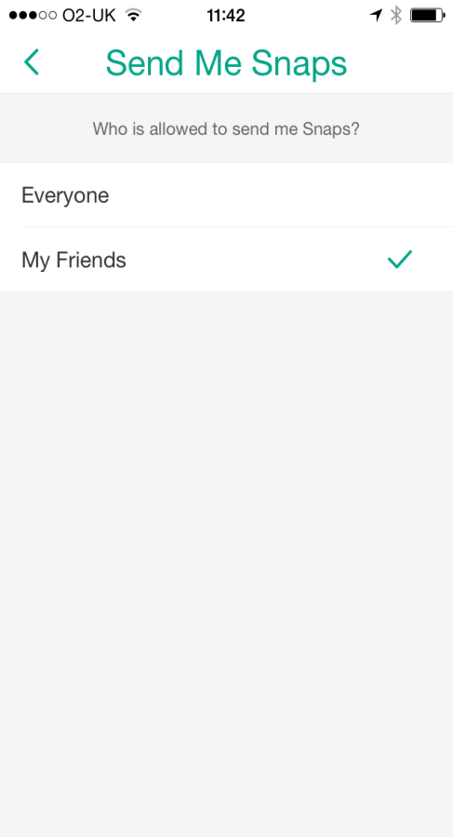
Snapchat
Notes:
It’s been another busy year and i think there have been lots of highlights:
You can make a difference – as a message, conference theme and as a campaign – has been really successful
The training videos worked out really well – a lot of time was spent working with SYT and Urbancroft to get them right and I think they’ve turned out really well – especially the Allan’s Primary section!
Campaigns have been successful again – and are probably the area of work I enjoy the most
The conference was fantastic with input from CYP and the feedback was really positive
Cinema advert – because it was our first
Drama
ABW – always a joy!
New respectme team

Slide 23

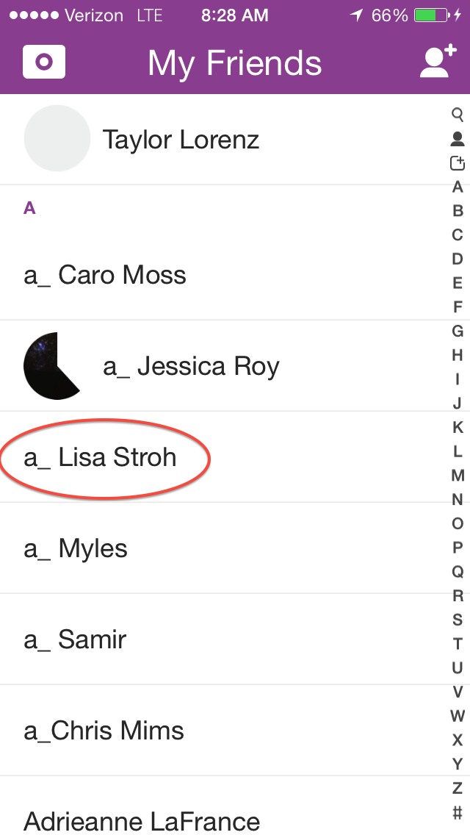
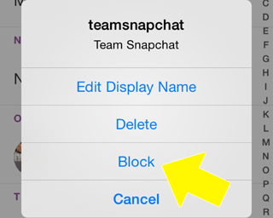


Slide 24

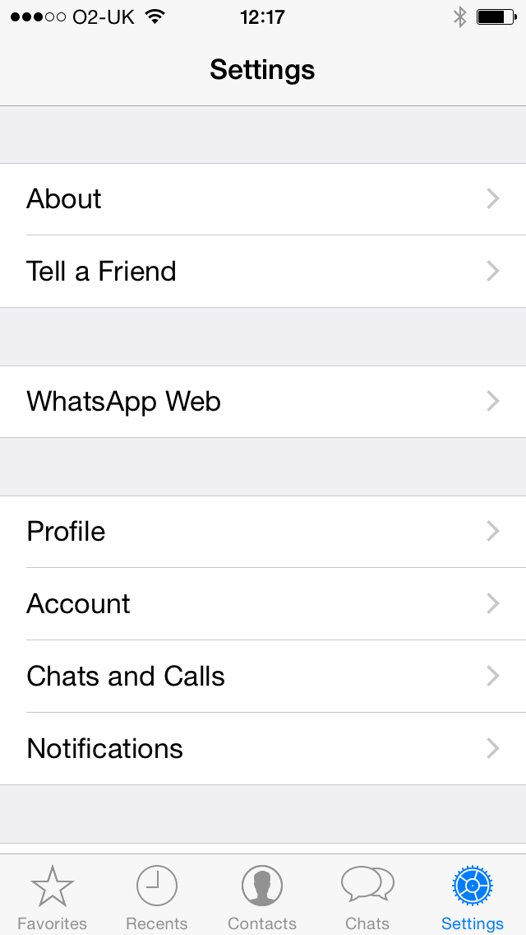
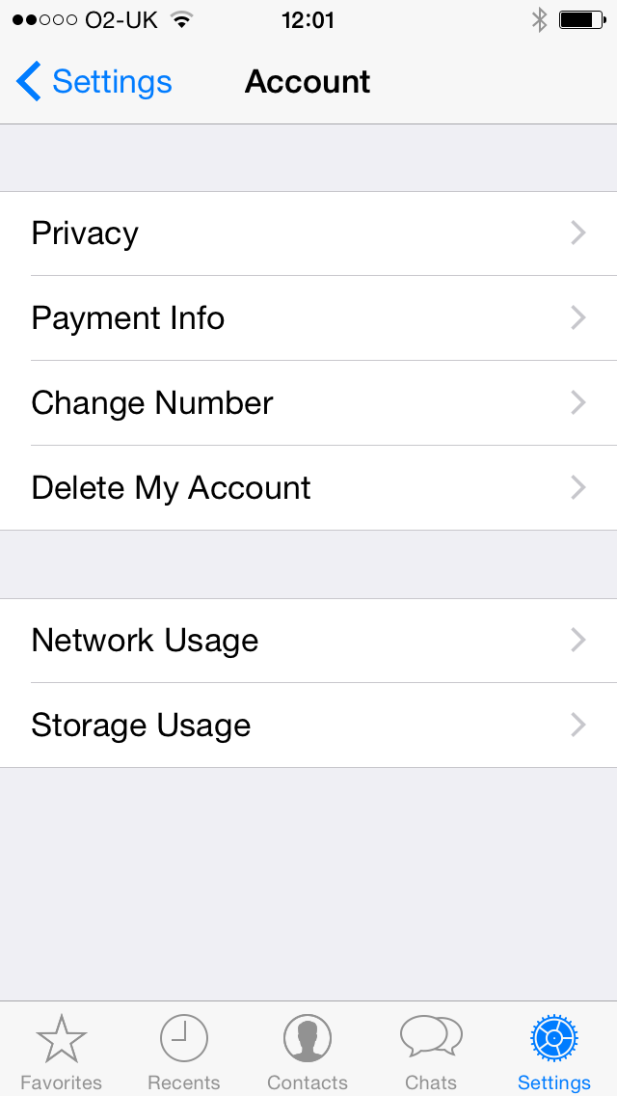
WhatsApp

Slide 25
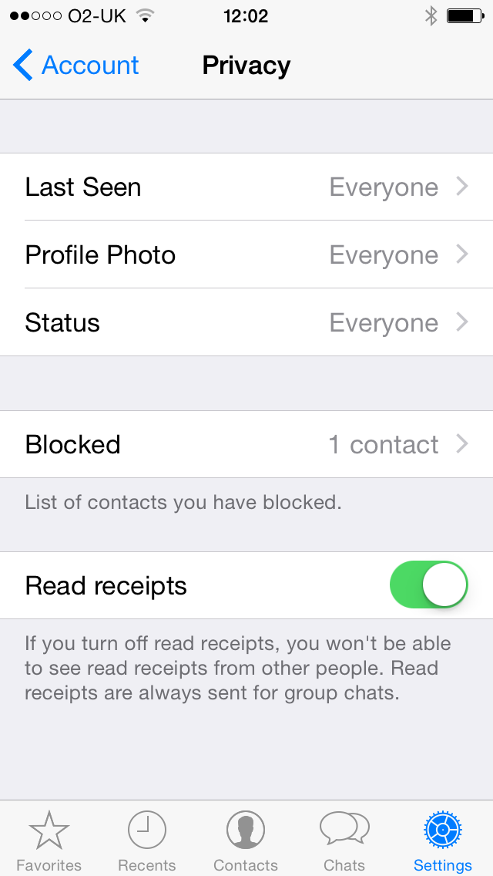
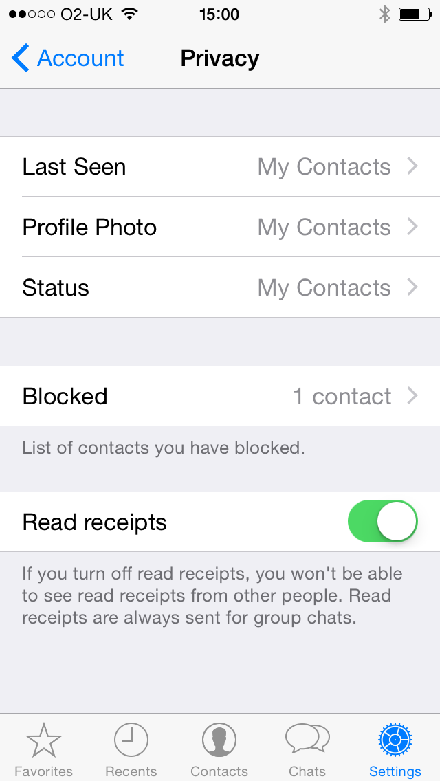

WhatsApp

Slide 26

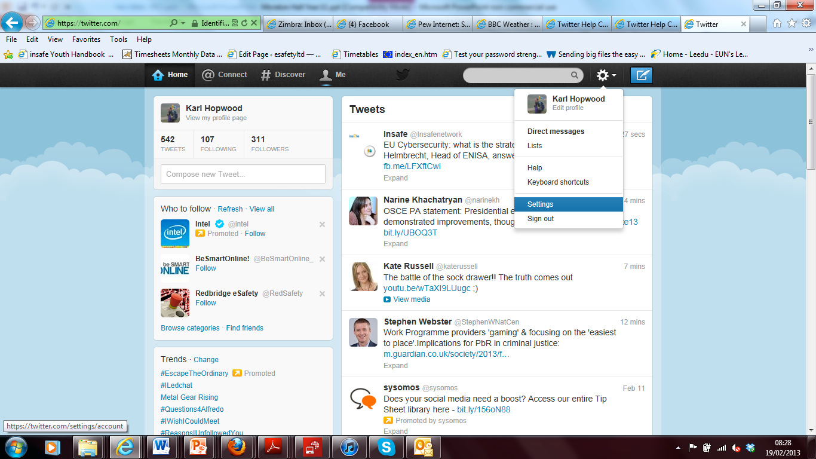
Twitter
Click on settings icon
Choose settings

Slide 27
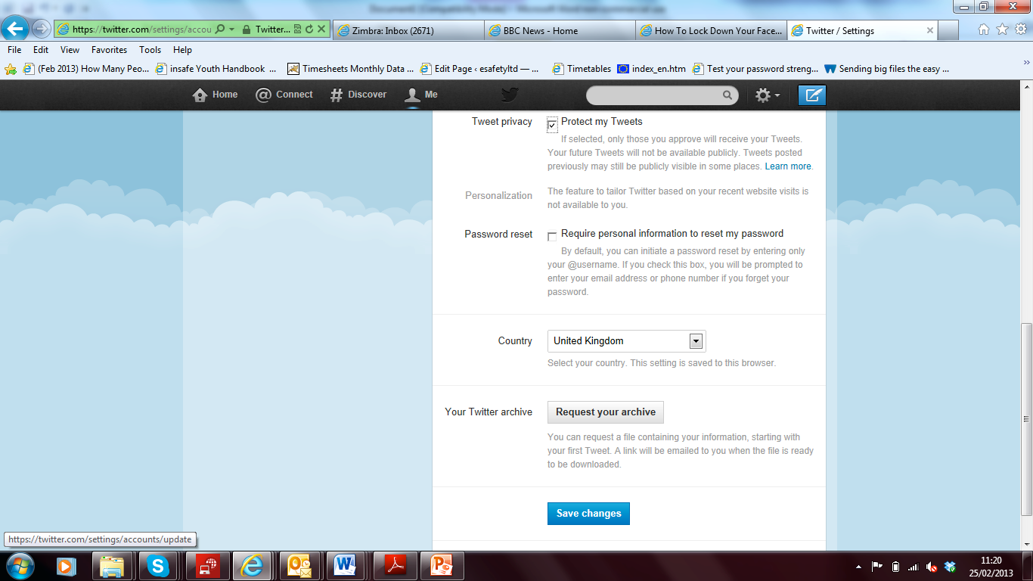
Scroll down to privacy and ensure there is a tick in box “Protect my Tweets”
Remember to save changes

Slide 28
Internet Safety-Further Resources
CEOPC (Child Exploitation and Online Protection Centre) www.ceop.police.uk/
Thinkuknow www.thinkuknow.co.uk/
UK Safer Internet Centre www.saferinternet.org.uk/
Cybersmile www.cybersmile.org/
Digizen – promoting safe online communities www.digizen.org/
NSPCC Net Aware http://www.net-aware.org.uk/
Internet Matters http://www.internetmatters.org/

Slide 29
lisa.armstrong@respectme.org.uk
Thank you

